Slide 1
ARCHITECTURE & CORE CONCEPTS
React Fundamentals & State Management
Component architecture, routing parameters, Higher-Order Components, Context API, and Redux data flow

Slide 2

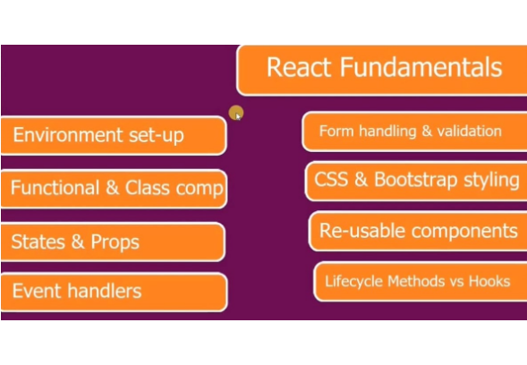
01 / CURRICULUM OVERVIEW
React Fundamentals Roadmap
Core Building Blocks
Environment setup, component syntax, state, and props.
Interactive UI & Lifecycle
Event handlers, form validation, styling, and React Hooks.

Slide 3
02 / FOUNDATION PILLARS
Core Architecture Pillars
Environment Set-up
Component Types
States & Props
Event Handlers
Node.js runtime with modern build bundling.
Stateless functional views versus class syntax.
Internal component memory versus external inputs.
Synthetic browser events triggering state updates.

Slide 4




03 / APPLICATION LAYER
UI Engineering & Lifecycle
Form Handling & Validation
CSS & Bootstrap Styling
Controlled inputs with real-time schema verification.
Modular stylesheets paired with responsive utility grids.
Re-usable Components
Lifecycle Methods vs Hooks
Composable UI primitives driven by dynamic props.
Declarative useEffect synchronization replacing class lifecycles.

Slide 5

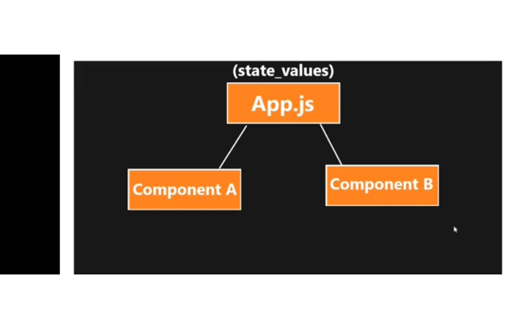
04 / UNIDIRECTIONAL DATA FLOW
Shared State Across Components
Root State Container: App.js holds centralized state_values.
Downward Distribution: Parent passes state to Component A.
Sibling Synchronization: Component B receives identical state updates.
Single Source: Prevents desynchronized local component data.

Slide 6

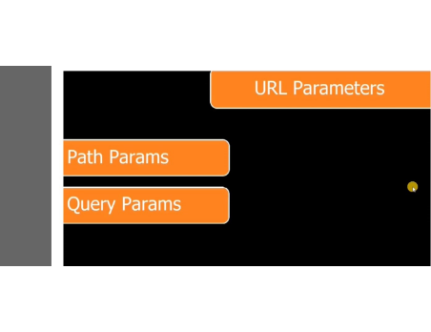
05 / DYNAMIC ROUTING
URL Parameters: Path vs Query
/users/:id
?sort=asc&page=2
Path Params
Query Params
Identifies specific mandatory resources via useParams hook.
Controls optional filtering or pagination via useSearchParams.

Slide 7
PART II / ADVANCED PATTERNS
Logic Reuse & Global State Architecture

Slide 8

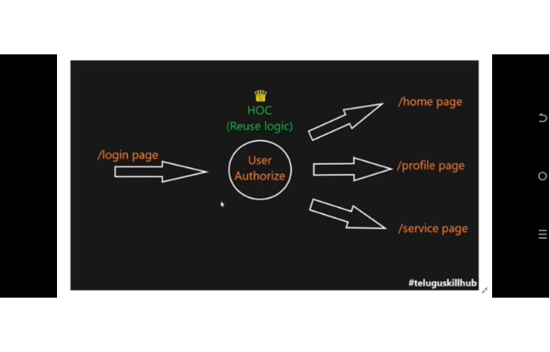
06 / AUTHORIZATION GUARD PATTERN
Higher-Order Components (HOC)
Centralized Auth Gate
Verifies credentials from /login page once.
Protected Route Wrapper
Grants access to /home, /profile, and /service pages.

Slide 9

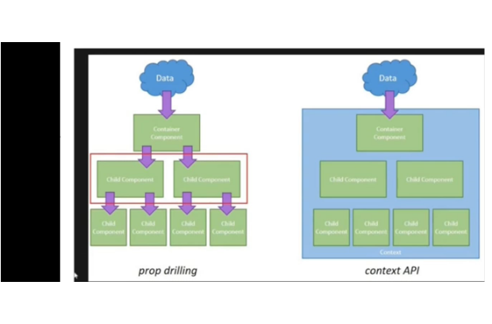
07 / COMPONENT TREE TELEPORTATION
Prop Drilling vs. Context API
Prop Drilling
Forces data manually through every intermediate child component.
Context API
Broadcasts data directly to any nested consumer component.

Slide 10


08 / PREDICTABLE STATE CONTAINER
Redux Unidirectional Data Flow
STEP 01
STEP 02
STEP 03
STEP 04
Action Creators
Reducer
Central Store
React Component
Dispatches action payload.
Computes next state purely.
Saves updated state tree.
Re-renders subscribed UI.

Slide 11

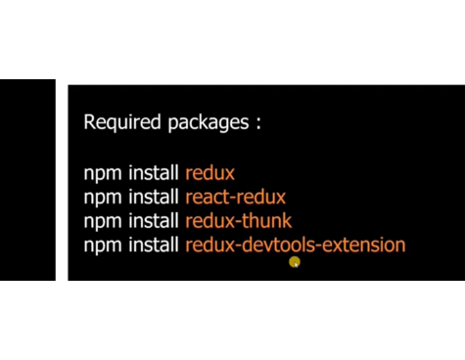
09 / ECOSYSTEM TOOLING
Required Redux Packages
Package | Core Responsibility
redux | Core state store and reducer engine
react-redux | Official React bindings and hooks
redux-thunk | Asynchronous API action middleware
redux-devtools-extension | Time-travel state debugging inspector

Slide 12
SUMMARY & NEXT STEPS
Ready to Build Scalable React Apps
Combine modular components, protected HOC routes, Context providers, and Redux stores for production architecture.

